Slide 1


Sabbath School Lesson
INSIGHTS
Touch Point Ministry

Slide 2
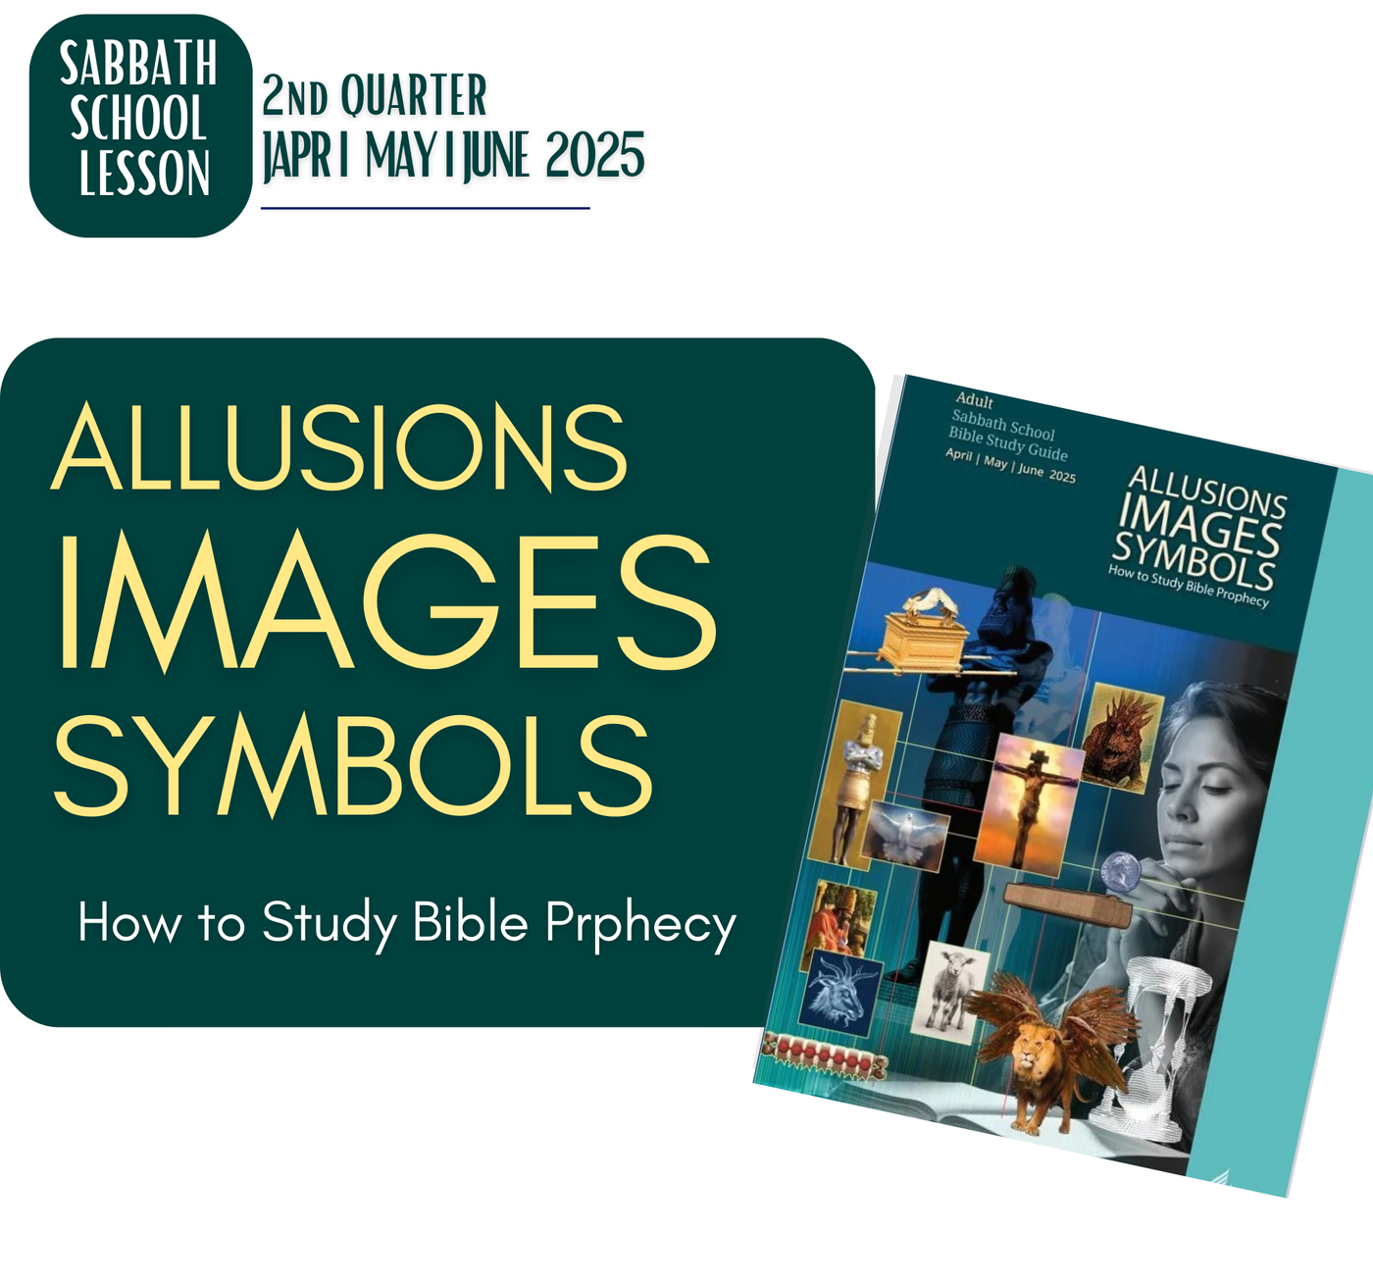

Slide 3
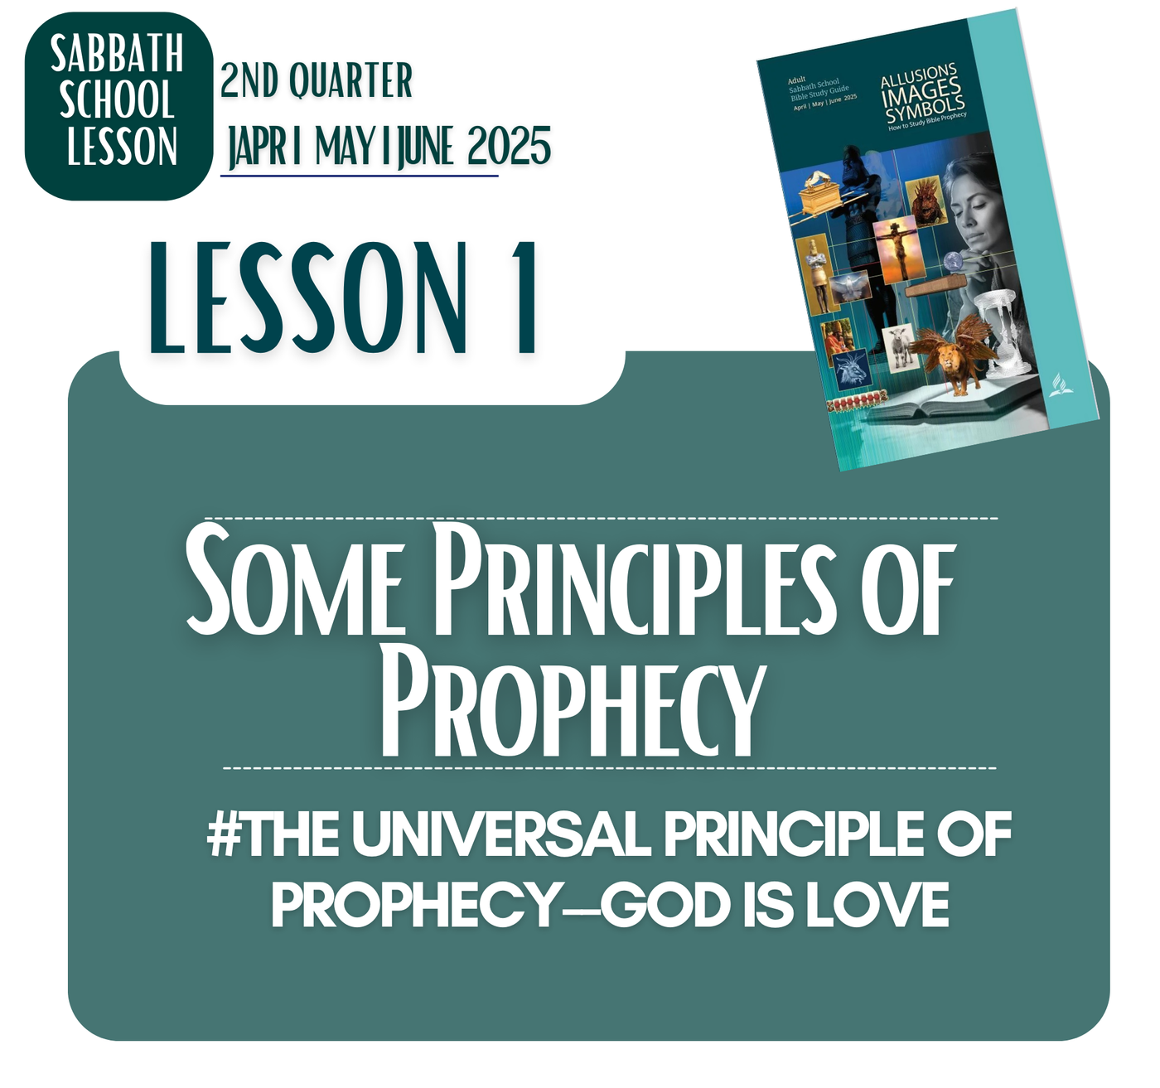

Slide 4
LESSON 1: SOME PRINCIPLES OF PROPHECY
MEMORY TEXT
“ ‘But let him who glories glory in this, that he understands and knows Me, that I am the Lord, exercising lovingkindness, judgment, and righteousness in the earth. For in these I delight,’ says the Lord”
Jeremiah 9:24, NKJV

Slide 5


LESSON 1: SOME PRINCIPLES OF PROPHECY
OPENING POINTS
JESUS’S LOVE IS NEVER HARD TO UNDERSTAND
JESUS REVEALED IN EVERY LINE
GOD’S WORK IS NEVER HARD TO UNDERSTAND
GOD REVEALED HIMSELF IN JESUS
JESUS MADE CLEAR THE LOVE OF GOD
JESUS’S MESSAGE ABOUT GOD IS CLEAR
GOD DOES NOT MAKE THINGS DIFFICULT FOR US TO KNOW HIM
GOD REVEALED THE MOST IMPORTANT PART IF HIMSELF
JESUS WANTS US TO KNOW HIM MORE
GOD WILL NEVER STOP REVEALING HIMSELF
#THE UNIVERSAL PRINCIPLE OF PROPHECY--GOD IS LOVE

Slide 6
LESSON 1: SOME PRINCIPLES OF PROPHECY
BACKGROUND
d
WHAT DOES PROPHECY MEAN TO YOU?
FOR US TODAY, PROPHECY IS A VERY DISTANT TOPIC THAT MAKES US SCARED, DISINTERESTED, UNCOMFORTABLE, CONFUSED, OR UNBOTHERED.
FOR THOSE WHO RECEIVED THOSE PROPHETIC SIGNS, IMAGERIES, AND SYMBOLS, IT WAS PURE HOPE, PURE HOPE OF A GOD WHO IS NOT DISTANT BUT A GOD WHO HAS A PLAN AND A GOD WHO CARES FOR THEM
PROPHECIES WERE INTENDED FOR THOSE WHO RECEIVED THEM A SOURCE OF HOPE OF A FUTURE WHERE GOD STILL MOVES, IT WAS A HOPE FOR HOW THEY ALIGN THEIR LIVES WITH GOD.

Slide 7
LESSON 1: SOME PRINCIPLES OF PROPHECY I SATURDAY AFTERNOON
INTRODUCTION
PROPHECIES ARE CHRISTIAN’S HOPE OF A PROMISED FUTURE WITH GOD.
THEY ARE MARKERS OF GOD’S PROMISES OF A SECURED FUTURE FOR THOSE WHO CHOOSE HIM.
THEY ARE GOD’S SIGN POSTS THAT HE HAS A PLAN.
PROPHECIES TELL US THAT GOD HAS A PLAN, GOD HAS A DEFINITE PLAN, GOD IS NOT JUST DISTANT AND UNBOTHERED; GOD IS WORKING BEHIND THE SCENES OF OUR HISTORY.
PROPHECIES POINT US DEFINITELY TO CHRIST, THE ULTIMATE FULFILLMENT OF GOD’S PROPHESIED PROMISE OF GOD’S PRESENCE IN OUR STORY.

Slide 8
LESSON 1: SOME PRINCIPLES OF PROPHECY I SUNDAY
Whoever Reads, Let Him Understand
MAIN THOUGHT
Scripture Reference: Matthew 24:15; Revelation 1:3; Matthew 11:29; and Jeremiah 9:23, 24.
WHAT IS THE UNIVERSAL TRUTH REVEALED IN THE PROPHECY?
WE HAVE A GOD WHO IS ALIVE, WHO IS INVOLVED, WHO IS WORKING BEHIND THE SCENES, NOT ACCORDING TO WHAT WE COULD UNDERSTAND, NOT ACCORDING TO WHAT WE WANT, BUT ACCORDING TO HIS JUST AND RIGHTEOUS PLAN.
MANY TIMES WE GO THROUGH THE DETAILS OF THE PROPHECY WITHOUT EVEN THE RIGHT UNDERSTANDING OF THE UNIVERSAL PICTURE AND MEANING IT IS TRYING TO TELL US.
WHATEVER HAPPENS TO US AND THE WORLD, GOD IS JUST, RIGHTEOUS, AND LOVE AND HE WILL NEVER EVER FAIL IN HIS PLANS FOR THE GOOD OF ALL HIS CREATION.

Slide 9
LESSON 1: SOME PRINCIPLES OF PROPHECY I SUNDAY
Whoever Reads, Let Him Understand
ANSWER TO THE MAIN QUESTIONS
Q: Someone not known to be pious was found reading the Bible. When asked what he was doing, he responded, “Looking for loopholes. Looking for loopholes.” Why is that exactly the wrong attitude to have when reading God’s Word?
ANSWER:
GOD’S WORDS, THE BIBLE IS NOT ACTUALLY WRITTEN TO PROVE AND CONVINCE THOSE WHO CHOOSE NOT TO BELIEVE BUT RATHER TO ASSURE, TO COMFORT, TO HONOR, TO TRANSFORM, AND TO SECURE THOSE WHO WANT TO BELIEVE. THE BIBLE IS FOR THOSE WHO WANTED TO KNOW ABOUT GOD, WHO SINCERELY WANT TO BE FREED FROM SIN, WHO SINCERELY THIRST FOR GOD’S PRESENCE. WE CANNOT CONVINCE ANY LONGER THOSE WHO DO NOT WANT TO BELIEVE. BUT FOR THOSE WHO WANTED TO BELIEVE, THEY NEEDED THE SUPPLY OF ALL THE HOPE THEY NEEDED, THE COMFORT THEY NEEDED.

Slide 10

Further Emphasis
LESSON 1: SOME PRINCIPLES OF PROPHECY I SUNDAY
Whoever Reads, Let Him Understand
JESUS’S LOVE IS NEVER HARD TO UNDERSTAND
FOR THOSE WHO ARE SEEKING, THIRSTING, AND HUNGERING, JESUS’S LOVE IS NEVER DIFFICULT TO BELIEVE. FOR THOSE WHO ARE BROKEN, LOST, AND DYING IN SIN, JESUS’S LOVE IS THE GOOD GOOD NEWS. FOR ALL THESE PEOPLE WHO CHOOSE GOD, THE PROPHECY IS THEIR ONLY HOPE AND ANCHOR TO HOLD TO IN TIMES OF THERE BIGGERST STROM.
How can this reality shape my life?
GOD’S WORK IS NEVER HARD TO UNDERSTAND
FOR THE MIND WHO ARE OPEN FOR GOD, AND WHO ARE SUBMITTED TO GOD, THEY ARE ABLE TO UNDERSTAND GOD NOT BECAUSE IT IS ALL CLEAR, BUT BECAUSE OF EVEN A VERY LITTLE THING THEY UNDERSTAND ABOUT HIM. IN GOD’S WORK IS NOT ABOUT HOW I FEEL AND UNDERSTAND BUT HOW TRUSTWORTHY GOD’S LOVE IS. WE UNDERSTAND GOD NOT ACCORDING TO THE EVENTS BUT ACCORDING TO HIS CHARACTER.

Slide 11
LESSON 1: SOME PRINCIPLES OF PROPHECY I MONDAY
God Wants to Be Understood
MAIN THOUGHT
Scripture Reference: Ps. 139:1–6; Ps. 147:5; Rom. 11:33; 1 John 3:20
GOD IS DIVINE, AND WE ARE FALLEN HUMAN BEINGS. WE DO NOT HAVE THE CAPACITY TO KNOW GOD AT ALL. BUT GOD’S MERCY MADE HIMSELF KNOWN TO US; HE NEVER EVER WITHHOLDS THE CHANCE FOR US TO KNOW HIM; EVEN IN A VERY LIMITED MANNER. GOD TOOK EVEN THE SLIGHTEST CHANCE FOR US TO UNDERSTAND HIM.
GOD IS NEVER DISTANT WHO WANTS TO BE REACHED BY HUMANS; HE IS A GOD WHO OFFERED HIMSELF TO BE KNOWN. GOD OFFERED HIMSELF TO BE KNOWN BECAUSE HE IS A GOD LIKE THAT TO US FALLEN HUMAN BEINGS.
Jeremiah 24:7 (NIV)
"I will give them a heart to know me, that I am the Lord. They will be my people, and I will be their God, for they will return to me with all their heart."

Slide 12
LESSON 1: SOME PRINCIPLES OF PROPHECY I MONDAY
God Wants to Be Understood
ANSWER TO THE MAIN QUESTIONS
Q: Though, yes, there is much that we don’t know, why is it crucial to focus now on what we do know and to follow what we know—as opposed to obsessing over what we don’t know?
ANSWER:
WHAT WE NOW KNOW IN THE BIBLE IS WHAT GOD REVEALED HIMSELF TO BE. EVEN IN WHAT GOD REVEALED HIMSELF TO BE IN THE SCRIPTURES, WE STILL CANNOT EXHAUST ALL THERE IS TO KNOW ABOUT GOD.
HOWEVER, THERE IS ONLY ONE THING THAT WE CAN REALLY KNOW AND FOCUS OUR SELVES INTO THAT GOD IS LOVE. STUDY HIS LOVE, UNDERSTAND HIS LOVE, UNDERSTAND THE NATURE OF HIS LOVE.
ONLY THIS KNOWLEDGE THAT WILL TRULY TRANSFORM OUR LIVES.

Slide 13
Further Emphasis
LESSON 1: SOME PRINCIPLES OF PROPHECY MONDAY
God Wants to Be Understood
JESUS MADE CLEAR THE LOVE OF GOD
John 14:9 (NIV) "Anyone who has seen me has seen the Father. How can you say, ‘Show us the Father’?"
Jesus reveals that He is the perfect reflection of God’s nature. When we look at Jesus, we see God’s love, mercy, and grace fully displayed. Jesus' life, death, and resurrection make God's love clear and accessible to all. He didn’t just teach about God's love; He embodied it. Jesus’ love is shown most powerfully on the cross, where He laid down His life for humanity.
How can this reality shape my life?
GOD DOES NOT MAKE THINGS DIFFICULT FOR US TO KNOW HIM
John 6:37 (NIV)
"All those the Father gives me will come to me, and whoever comes to me I will never drive away."
Jesus makes it clear that God does not turn anyone away who seeks to know Him. There are no complex hoops to jump through, no hidden barriers to cross. The invitation is open to all—God’s heart is for us to come to Him as we are. Jesus promises that no one who comes to Him will be rejected.

Slide 14
LESSON 1: SOME PRINCIPLES OF PROPHECY I TUESDAY
Daniel—Shut Up the Words
MAIN THOUGHT
Scripture Reference: Daniel 12:4
The birth of our global movement, in other words, is a fulfillment of Daniel’s prediction that “knowledge shall increase” at “the time of the end.”
OUR KNOWLEDGE AND UNDERSTANDING OF GOD’S LOVE WILL SURELY INCREASE.
THERE IS NO OTHER KNOWLEDGE THAT GOD IS MOST CONCERNED ABOUT AND THAT THE KNOWLEDGE OF WHO HE IS BECAUSE THAT IS THE KNOWLEDGE THAT SATAN WANTED TO WIPE OUT. SATAN WANTED TO TAKE AWAY FROM PEOPLE’S LIVES A KNOWLEDGE OF GOD WHO DEEPLY, TRULY LOVES THEM, WHO DOES HIS BEST TO REACH OUT THE FALLEN HUMANITY--DESPITE UNWORTHY, DESPITE REBELLIOUS, GOD CONTINUED TO REACH OUT RELENTLESSLY.

Slide 15
Further Emphasis
LESSON 1: SOME PRINCIPLES OF PROPHECY I TUESDAY
Daniel—Shut Up the Words
JESUS WANTS US TO KNOW HIM MORE
John 17:3 (NIV)
"Now this is eternal life: that they know you, the only true God, and Jesus Christ, whom you have sent."
Jesus defines eternal life as knowing God and Himself. Eternal life isn’t just about living forever; it’s about a deep, intimate relationship with God. Jesus desires for us to know Him more, to experience Him in a way that transforms us. This knowledge is relational, not just intellectual.
How can this reality shape my life?
GOD WILL NEVER STOP REVEALING HIMSELF
Ephesians 3:17-19 (NIV)
"So that Christ may dwell in your hearts through faith. And I pray that you, being rooted and established in love, may have power, together with all the Lord’s holy people, to grasp how wide and long and high and deep is the love of Christ, and to know this love that surpasses knowledge—that you may be filled to the measure of all the fullness of God." SEEING THE WORKS OF JESUS FROM THE SCRIPTURES WE SEE THE DEEP LOVE OF GOD.

Slide 16
LESSON 1: SOME PRINCIPLES OF PROPHECY I WEDNESDAY
Studying the Word
MAIN THOUGHT
Scripture Reference: Matthew 5:18, 2 Timothy 3:15–17, and Luke 24:27
THE BIBLE IS WRITTEN FOR BUT NOT TO US. IT MEANS THE BIBLE HAS CERTAIN PLACES, PEOPLE AND SITUATION THAT IT WAS WRITTEN TO AND ABOUT. WE CANNOT JUST ASSUME EVERYTHING AS IT IS DIRECTLY WRITTEN TO US.
WE CAN SEE THE UNIVERSAL MESSAGE OF GOD’S LOVE, RIGHTEOUSNESS, JUSTICE, MERCY, AND GRACE IN EVERY EVENTS, STORIES, PROPHECIES, AND PEOPLE OF THE PAST. THE REVELATION OF GOD’S CHARACTER THAT ARE ALSO FOR US.
IT IS GOD’S LOVE THAT WE CAN STUDY, IT IS GOD’S MERCY THAT WE CAN LEARN, IT IS GOD’S GRACE THAT WE CAN KNOW FROM WHAT IS WRITTEN FOR US EVEN NOT TO US.

Slide 17
LESSON 1: SOME PRINCIPLES OF PROPHECY I WEDNESDAY
Studying the Word
ANSWER TO THE MAIN QUESTIONS
Q: What has been your experience with those who use only certain selected texts to try to make their point about, say, the state of the dead? Or even the Sabbath? What is the best way to respond?
ANSWER:
IT IS HARD TO ARGUE IF THEY ARE ALREADY FIXED TO THAT WAY. THE BEST WAY TO RESPOND IS NOT TO INSIST BUT TO LISTEN AND WHEN WE ARE GIVEN THE CHANCE PRESENT IN A VERY HUMBLE WAY THE EXEGETICAL WAY OF THE EXPLAINING THE SCRIPTURE.
WE ARE NOT TO ARGUE, WE ARE ONLY TO WAIT FOR OUR TURN. AND WHEN IT IS OUR TURN LET US USE THE TIME GIVEN US TO PRESENT THE BEST AND MOST TRUTHFUL WAY OF TREATING THE SCRIPTURES.

Slide 18
Further Emphasis
LESSON 1: SOME PRINCIPLES OF PROPHECY I WEDNESDAY
Studying the Word
JESUS REVEALED IN EVERY LINE
John 5:39 (NIV)
"You study the Scriptures diligently because you think that in them you have eternal life. These are the very Scriptures that testify about me."
Luke 24:27 (NIV)
"And beginning with Moses and all the Prophets, he explained to them what was said in all the Scriptures concerning himself." THE BIBLE IS ALL ABOUT JESUS AND GOD’S LOVE AND HIS WORK OF SALVATION.
How can this reality shape my life?
GOD REVEALED HIMSELF IN JESUS
Hebrews 1:1-2 (NIV)
"In the past God spoke to our ancestors through the prophets at many times and in various ways, but in these last days he has spoken to us by his Son, whom he appointed heir of all things, and through whom also he made the universe."
The prophets and Scriptures in the Old Testament were partial revelations of God's plan, but in Christ, God's ultimate message is fully revealed. Jesus is not just the messenger; He is the message itself, revealing God’s character, will, and purpose for humanity. Every line of the Old Testament and New Testament is pointing toward Christ, who is the ultimate fulfillment of God's plan.
Notes:
zWHEN LIFE GETS PRETTY IT IS SO EASY FOR ME TO FORGET DARKER DAYS OF LIFE AND WHO I EXACTLY WAS AT THAT TIME. THIS IS LIKE CYCLE THAT HAPPENS TO US. WE JUST KEEP ON FALLING INTO THE TRAP OF SUFFER-PLEAD-RELIEVED-REJOICE-FORGET.
I CAME TO A POINT OF EXHAUSTION FROM THIS CYCLE. FINALLY, I GET TO SEE WHO I REALLY WAS. WHEN DARK TIMES HAPPEN, I GO TO GOD BECAUSE I WANTED TO BE RELIEVED AND BE OUT OF THE PAIN, IT WASN'T GOING BECAUSE I KNOW HIM AS A GREAT AND MIGHT GOD AND I FEAR HIM, BUT BECAUSE I WAS JUST WANTING OUT FROM MY DESPERATE SITUATION. THEN NO MATTER WHAT IS THE CONDITION OF MY HEART GOD COMES AND RESCUES ME...
THEN FORGET GOD RIGHT AFTER THE RELIEF. I WOULD BE SO BUSY TELLING HOW TOUGH IT WAS FORGETTING HOW GOD WAS THERE. BECAUSE IN THE VERY FIRST PLACE, I DID NOT WANT GOD ONLY WHAT HE CAN DO TO ME.
IT IS SO EASY TO FORGET MY PAST AND NEVER LEARN FROM IT. BUT IF I GO TO GOD FROM A LOVE RELATIONSHIP WITH GOD. I WANT GOD NOT FOR RELIEF BUT FOR HIS PRESENCE, IT IS PRESENCE ALONE THAT IS MY RELIEF, WHAT REALLY AGONIZES ME IS NOT THE PHYSICAL PAIN BUT THE WHISPERS OF SATAN THAT GOD IS NOT WITH ME...
WE FORGET WHEN WE TREAT GOD AS A RESCUER NOT AS SOMEONE YOU ARE INTIMATELY ATTACHED TO.

Slide 19
LESSON 1: SOME PRINCIPLES OF PROPHECY I THURSDAY
Figurative or Literal?
MAIN THOUGHT
Scripture Reference: Dan. 7:7, Dan. 8:3, Dan. 7:24; Rev. 1:16; Eph. 6:17, Heb. 4:12; Rev. 12:1; Rev. 21:2; Eph. 5:31, 32; Jer. 6:2
THE SYMBOLS ARE LIKE MYSTERIES FOR US NOW BUT DURING THE TIME IT WAS WRITTEN TO, IT WASN’T A MYSTERY AT ALL, IT WAS A RELEVANT SYMBOL THAT IS EASILY GRASPED BY ANYONE IN LIVING IN THEIR TIME. IT WASN’T ABOUT A DIFFICULTY TO RELATE ITS MEANING BUT IT WAS ABOUT THE DEPTH OF GOD’S MESSAGE BEING REVEALED.
IN THIS DETAILS THAT IS HARD FOR US TO DETERMINE, WE CAN BE SURE THAT EVEN NOT KNOWING THE EXACT DETAILS OF THEM SURELY DOES NOT EXCLUDE US FROM KNOWING HIS TRUE CHARACTER.
THE MOST IMPORTANT DETAIL IS THE DETAIL OF OUR SALVATION IN CHRIST WHICH IS FREELY REVEALED AT THE CROSS. FOR MATTERS OF GREAT DEPTH AND IMPORTANCE THAT CHANGES OUR LIVES, WE HAVE A MESSAGE SO CLEAR. FOR SOME DETAILS OF THE EVENTS, PEOPLE, ETC, MANY TIMES THEY ARE NOT FULLY REVEALED AND FOR WHAT REASON IT IS, ONLY GOD KNOWS AND WE CAN ONLY EXPECT HIS GOODNESS.

Slide 20
LESSON 1: SOME PRINCIPLES OF PROPHECY I THURSDAY
Figurative or Literal?
ANSWER TO THE MAIN QUESTIONS
Q: Even if some symbols and prophecies remain mysteries, how can focusing on what we do understand strengthen our faith?
ANSWER:
  Meditate on the Character of God: Focus on what you know to be true about God's nature—His love, goodness, and faithfulness. These aspects of His character never change, and meditating on them strengthens your trust in Him.
  Celebrate the Gospel: Reflect on the completed work of Christ—His death, resurrection, and promise of eternal life. This is the heart of our faith and the foundation upon which everything else rests.
  Pray for Understanding: Ask God to help you understand more of the mysteries of the faith. The Holy Spirit is our teacher and will guide us into all truth (John 16:13).
  Live in Hope: Focus on the promises of the future—Christ’s return, the resurrection, and the restoration of all things. These truths give us hope that strengthens our faith in the present.

Slide 21
Further Emphasis
LESSON 1: SOME PRINCIPLES OF PROPHECYI THURSDAY
Figurative or Literal?
JESUS’S MESSAGE ABOUT GOD IS CLEAR
Colossians 1:19-20 (NIV)
"For God was pleased to have all his fullness dwell in him, and through him to reconcile to himself all things, whether things on earth or things in heaven, by making peace through his blood, shed on the cross."
Jesus is the fullest revelation of God’s nature because all of God’s “fullness” dwells in Him. Everything that God is—His power, His holiness, His love—is revealed in Jesus. And not only does Jesus reveal God, but He also accomplishes God's greatest act of revelation: reconciling the world to Himself through His death on the cross. The cross is the ultimate demonstration of God’s love and holiness, showing us how far God is willing to go to restore a broken relationship with humanity.
How can this reality shape my life?
GOD REVEALED THE MOST IMPORTANT PART IF HIMSELF
GOD REVEALED HIS LOVE AND NOTHING MORE. John 3:16 (NIV)
"For God so loved the world that he gave his one and only Son, that whoever believes in him shall not perish but have eternal life." God’s most profound revelation of Himself is His love. In John 3:16, we see that God's love is not an abstract concept, but something that was demonstrated through action. The ultimate expression of God's love was giving His Son, Jesus Christ, to die for the sins of the world. This is the pinnacle of God's self-revelation—His love for humanity, not in mere words but in the sacrifice of His Son.

Slide 22







LESSON 1: SOME PRINCIPLES OF PROPHECY
Do's
Sin Problem
WE CONCERNED OURSELVES WITH THE DETAILS BUT MISSED THE UNIVERSAL PICTURE OF THE PROPHECIES. THE UNIVERSAL PICTURE OF HIS GREAT LOVE FOR SINNERS.
GOOD NEWS
#THE UNIVERSAL PRINCIPLE OF PROPHECY--GOD IS LOVE
Gospel Reality!
GOD IS LOVE AND THERE IS NO OTHER MUCH BIGGER REALITY!

Slide 23

LESSON 1: SOME PRINCIPLES OF PROPHECY
#THE UNIVERSAL PRINCIPLE OF PROPHECY--GOD IS LOVE
The foundation of all prophecy, in both the Old and New Testaments, is built upon the truth that God is love. Everything God reveals through prophecy, whether about future events, His plan for salvation, or His character, is rooted in His love for humanity.
This is the universal principle that guides the entirety of Scripture—God’s actions, His words, and His plans are all motivated by His perfect, sacrificial, and unconditional love. Prophecy, at its core, is not just about foretelling the future but about revealing God’s heart, His love, and His desire to redeem and restore a broken world.

Slide 24
LESSON 1: SOME PRINCIPLES OF PROPHECY
#THE UNIVERSAL PRINCIPLE OF PROPHECY--GOD IS LOVE
Jeremiah 29:11 (NIV)
"For I know the plans I have for you," declares the Lord, "plans to prosper you and not to harm you, plans to give you a hope and a future."
Prophecy always moves us toward the revelation of God’s goodness, even when it involves warning or discipline.
The fulfillment of all prophecy culminates in this future reality, where God’s love will bring about the complete restoration of creation. There will be no more suffering, death, or pain because God, in His love, will have completely restored everything. This promise, given through prophecy, reveals the depth of God’s love that desires not only to save us from our sin but to bring about a new creation where His love reigns forever.

Slide 25
LESSON 1: Some Principles of Prophecy
ANSWERS TO FRIDAY’S DICUSSION QUESTIONS:
Q1 : How can the study of prophecy greatly increase your faith? What prophecies—some written thousands of years ago about events that would happen hundreds, if not thousands of years later—have helped increase your trust in the Bible and, more important, in the God who inspired it? How, for example, does Daniel 2 give us powerful, and logical, reasons to trust not only that God exists but that He knows the future?
ANSWER:
The study of prophecy strengthens faith by showing that God has a sovereign plan for the world, and His word is trustworthy. Prophecies fulfilled throughout history demonstrate that God knows the future and is in control, which builds confidence in His promises.
Prophecies that increase trust:
  The Messianic prophecies (e.g., Isaiah 53, Micah 5:2) that pointed to Jesus' life, death, and resurrection, fulfilled centuries later.
  Daniel 2, where King Nebuchadnezzar's dream is interpreted, revealing future empires, showing God's control over history.

Slide 26
LESSON 1: Some Principles of Prophecy
ANSWERS TO FRIDAY’S DICUSSION QUESTIONS:
Q1 : How can the study of prophecy greatly increase your faith? What prophecies—some written thousands of years ago about events that would happen hundreds, if not thousands of years later—have helped increase your trust in the Bible and, more important, in the God who inspired it? How, for example, does Daniel 2 give us powerful, and logical, reasons to trust not only that God exists but that He knows the future?
ANSWER:
Daniel 2 gives powerful reasons to trust God by accurately predicting the rise and fall of major empires (Babylon, Medo-Persia, Greece, and Rome) long before they happened. This prophecy, fulfilled exactly as described, demonstrates that God not only exists but is sovereign over history, with perfect knowledge of the future. This establishes the reliability of Scripture and the God who inspired it.

Slide 27
LESSON 1: Some Principles of Prophecy
ANSWERS TO FRIDAY’S DICUSSION QUESTIONS:
Q1 : How can the study of prophecy greatly increase your faith? What prophecies—some written thousands of years ago about events that would happen hundreds, if not thousands of years later—have helped increase your trust in the Bible and, more important, in the God who inspired it? How, for example, does Daniel 2 give us powerful, and logical, reasons to trust not only that God exists but that He knows the future?
ANSWER:
Daniel 2 gives powerful reasons to trust God by accurately predicting the rise and fall of major empires (Babylon, Medo-Persia, Greece, and Rome) long before they happened. This prophecy, fulfilled exactly as described, demonstrates that God not only exists but is sovereign over history, with perfect knowledge of the future. This establishes the reliability of Scripture and the God who inspired it.

Slide 28
LESSON 1: Some Principles of Prophecy
ANSWERS TO FRIDAY’S DICUSSION QUESTIONS:
Q2 : What are the best ways to protect ourselves from the many wild and speculative attempts to interpret prophecies, sometimes even from those within our own church? Why must we be careful to “test all things; hold fast what is good” (1 Thess. 5:21, NKJV)?
ANSWER:
Best Ways to Protect Ourselves from Wild and Speculative Interpretations:
  Ground Yourself in Scripture: Ensure that any interpretation of prophecy aligns with the core teachings of the Bible. If it contradicts the clear message of Scripture, it should be rejected. The Bible is the ultimate authority.
  Context is Key: Always interpret prophecies in their proper historical, cultural, and literary context. Taking verses out of context can lead to distorted or speculative interpretations.
  Avoid Isolation in Interpretation: Prophecy should be interpreted with the help of others—preferably those who are well-versed in Scripture and church history. This collective understanding helps avoid personal bias.
  Be Cautious of Date-Setting or Sensationalism: Many speculative interpretations focus on predicting dates or sensational events. Stay cautious about anyone who claims to know "exactly" when prophetic events will occur, as Scripture warns against this (Matthew 24:36).
  Be Cautious of Personal Bias: Avoid letting personal desires or circumstances cloud judgment. Prophecies should not be interpreted to fit personal agendas or to predict events that cater to individual preferences.
  Test Prophecies Against Scripture: 1 John 4:1 encourages believers to test every spirit to see if it aligns with God's Word. If a prophecy or interpretation doesn't match biblical doctrine, it should be rejected.
  Consistency: A legitimate prophecy or interpretation will not contradict Scripture but will be in harmony with it.
  Prayer and Discernment: Pray for wisdom and discernment through the Holy Spirit when studying prophecy. God’s Spirit leads us into truth and protects us from error (John 16:13).

Slide 29
LESSON 1: Some Principles of Prophecy
ANSWERS TO FRIDAY’S DICUSSION QUESTIONS:
Q2 : What are the best ways to protect ourselves from the many wild and speculative attempts to interpret prophecies, sometimes even from those within our own church? Why must we be careful to “test all things; hold fast what is good” (1 Thess. 5:21, NKJV)?
ANSWER:
Why Test All Things (1 Thess. 5:21):
We must "test all things" because prophecy can easily be misinterpreted or misused. Even well-intentioned individuals can get caught up in speculative interpretations that sound appealing but are not rooted in biblical truth. Testing all things ensures:
  Protection from Deception: It keeps us from being led astray by false teachings or unfounded speculations.
  Preservation of Truth: By holding fast to what is good, we safeguard the purity and integrity of our faith and the gospel message.
  Growth in Sound Doctrine: Discernment helps us grow in biblical knowledge and strengthens our trust in God’s Word.
Ultimately, being cautious and testing everything helps us stay grounded in truth and avoid being swept away by human imaginations or unbiblical teachings.

